Slide 1
By using his tweeter account for over 11 years with a follower base of over 88 million people - former president of the USA Donald J Trump influenced the American people and the rest of the world in a variety of issues. Our research question is - On which subject did Trump have the most impact regarding public opinion?
Data Science Project
By:
Ron Hugi
Matan Roginsky

Slide 2
“Great. Most corrupt election in history, by far. We won!!!”
Donald J. Trump (after losing the election) – January 2021

Slide 3
The Process
Finding The Research Sources
Crawling
Data Manipulation
Analyzing the data and Visualizations
Machine Learning

Slide 4
The Research
Twitter is a microblogging and social networking service on which users post and interact with messages known as "tweets"
Media has the power to influence individual beliefs, attitudes, and behaviors. Thus, social norms that influence and encourage gender violence have been targeted by policy interventions using mass media communication

Slide 5
The Research
Twitter was founded in 2006, and has 230~ million users all over the world
Along with other huge social media platforms such as Facebook (Meta), TikTok, etc.
Popular users of these platforms sometimes have hundreds of millions of users following their every move, tweet and post and are influenced by them
Former USA president Donald J Trump had tens of millions of followers on Twitter
We aim to understand – On which topics did Trump influenced the most regarding public opinion by analyzing the tweets and the amount of ‘Likes’ and ‘Retweets’ they have received by Trump’s followers
We analyzed all 56,000~ of the tweets Trump posted over the years
By applying unsupervised learning methods we hope to find interesting and insightful results

Slide 6
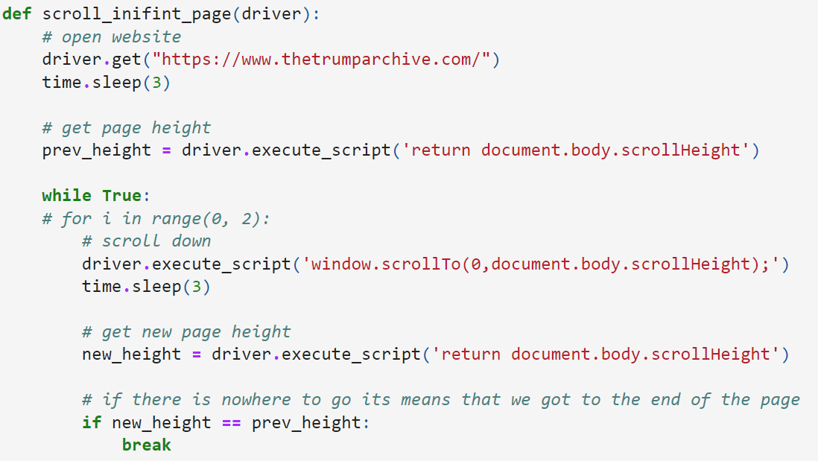
Crawling
Using selenium to scroll infinite page
Function phases:
open website with web driver
get the page height for calculations
in the loop, continue to scroll until the crawler calculate that we get all the infinite page
every 3 seconds we scroll, its 3 secs for the site will get that data from its server
What to do with the page:
After the Selenium finish to scroll
To get the number of the tweets we get the HTML element with CSS class "results___1pfEc"
To get all the tweet data using the CSS class "tweet___2xXtA"
for loop to get all the tweets, in the "div" element there is a json with the data

Slide 7
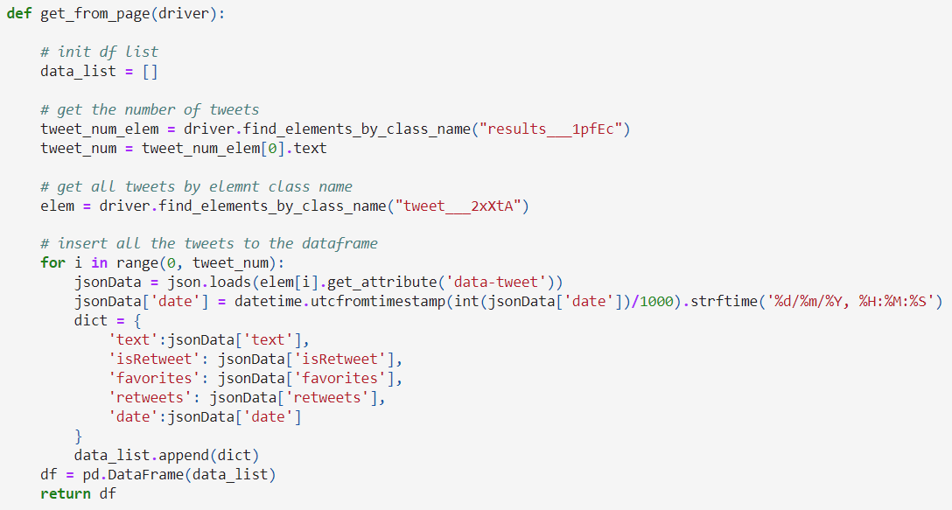
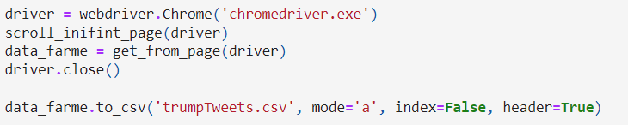
Crawling
Using selenium to scroll infinite page
Function phases:
open website with web driver
get the page height for calculations
in the loop, continue to scroll until the crawler calculate that we get all the infinite page
every 3 seconds we scroll, its 3 secs for the site will get that data from its server
What to do with the page:
After the Selenium finish to scroll
To get the number of the tweets we get the HTML element with CSS class "results___1pfEc"
To get all the tweet data using the CSS class "tweet___2xXtA"
for loop to get all the tweets, in the "div" element there is a json with the data

Slide 8
Data Manipulation
During the data manipulation phase, we created 8 function in order to clean the original data frame. We chose to produce 2 data frames, one with stemming and one with lemmatizing in order to compare how the different methods are different when vectorized and presented
remove_unnecessary_data
tokenizeTweets
cleanPunctuation
lemmataizeSentance
Stemming
cleanLinks
remove_emoji
remove_nan_rows
replace_empty_to_nan

Slide 9
Data Manipulation
Function – Remove Stops Words:
A stop word is a commonly used word (such as “the”, “a”, “an”, “in”) that a search engine has been programmed to ignore, both when indexing entries for searching and when retrieving them as the result of a search query. We would not want these words to take up space in our database, or taking up valuable processing time. For this, we can remove them easily, by storing a list of words that you consider to stop words. NLTK(Natural Language Toolkit) in python has a list of stopwords stored in 16 different languages. You can find them in the nltk_data directory. home/pratima/nltk_data/corpora/stopwords is the directory address.(Do not forget to change your home directory name)

Slide 10
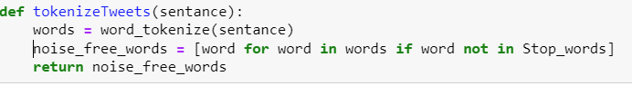
Data Manipulation
Function – tokenizeTweets:
splitting up a larger body of text into smaller lines, words, it is necessary for the machine learning models and algorithms that would be in use later

Slide 11
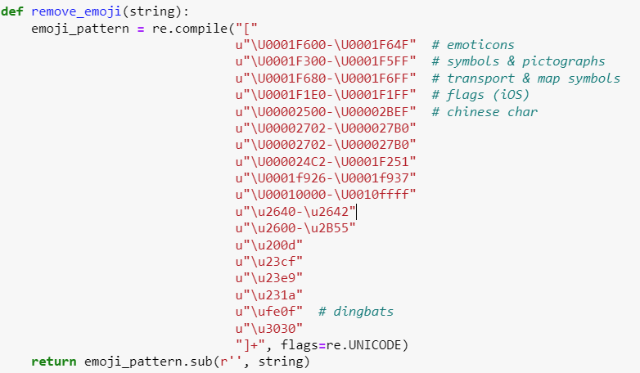
Data Manipulation
Function – remove_emoji:
The function is use for removing all emoji symbols that were used in the tweets and would not contribute to the data analyzing

Slide 12
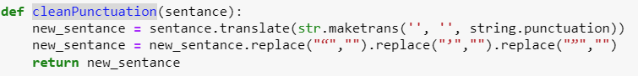
Data Manipulation
Function – cleanPunctuation:
The function removes punctuation symbols from the text, symbols that won’t contribute to the data analyzing phase

Slide 13
Data Manipulation
Function – cleanLinks:
The function cuts out links to other websites from the tweets

Slide 14
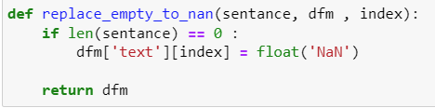
Data Manipulation
Function – replace_empty_to_nan:
The function replaces empty cell with NaN value

Slide 15
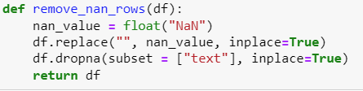
Data Manipulation
Function – remove_nan_rows:
The function removes all rows that have NaN values

Slide 16
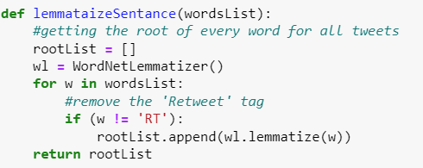
Data Manipulation
Function – lemmataizeSentance:
Lemmatization is the process of grouping together the different inflected forms of a word so they can be analyzed as a single item. Lemmatization is similar to stemming but it brings context to the words. So it links words with similar meanings to one word - a process required before vectorizing the words

Slide 17
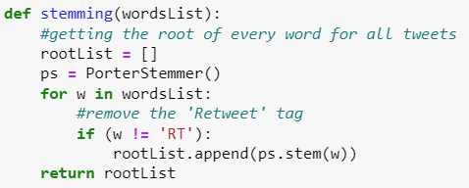
Data Manipulation
Function – Stemming:
Stemming is the process of reducing inflection in words to their root forms such as mapping a group of words to the same stem even if the stem itself is not a valid word in the Language – a process required before vectorizing the words

Slide 18
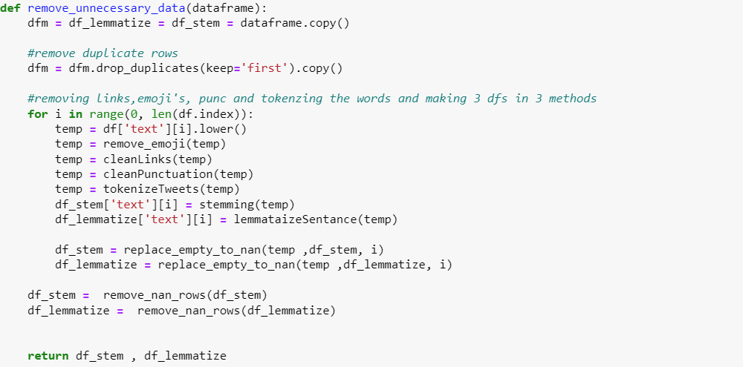
Data Manipulation
Function – remove_unnecessary_data:
The function receives the raw data frame and runs all the other function mentioned before on each and every tweet
The function return 2 data frame, one a clean data frame that what stemmed, and one clean data frame that was lemmatized

Slide 19
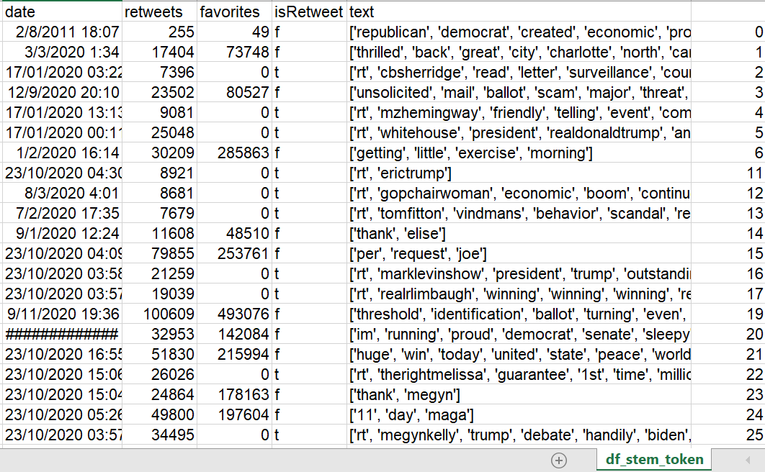
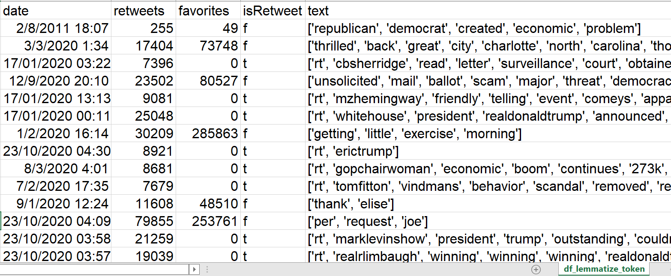
Data Manipulation
Function – remove_unnecessary_data:
The function receives the raw data frame and runs all the other function mentioned before on each and every tweet
The function return 2 data frame, one a clean data frame that what stemmed, and one clean data frame that was lemmatized
After cleaning the data frame 1000~ rows of unnecessary data were removed
Stemmeing
Lemmatizing

Slide 20
Analyzing the data and Visualizations
We used a number of algorithms in order to analyze and visualize the data we collected and answer our research question. We tested all the algorithms with both the stemmed data frame and the lemmatized data frame
TFIDF
K-means
Doc2Vec
K-means
LDA

Slide 21
Analyzing the data and Visualizations
Creating a vector with Doc2Vec, clustering and displaying it with k-means
Doc2Vec is an NLP tool for representing documents as a vector and is a generalizing of the word2vec method.
After many tests we decided to use 5 clusters for our research

Slide 22
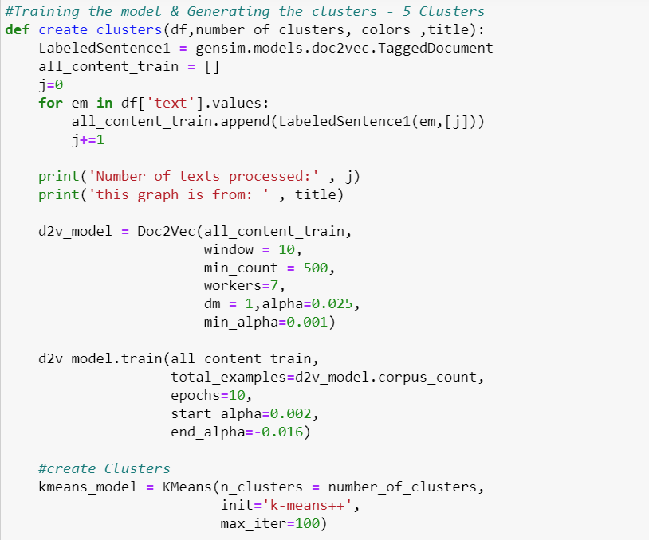
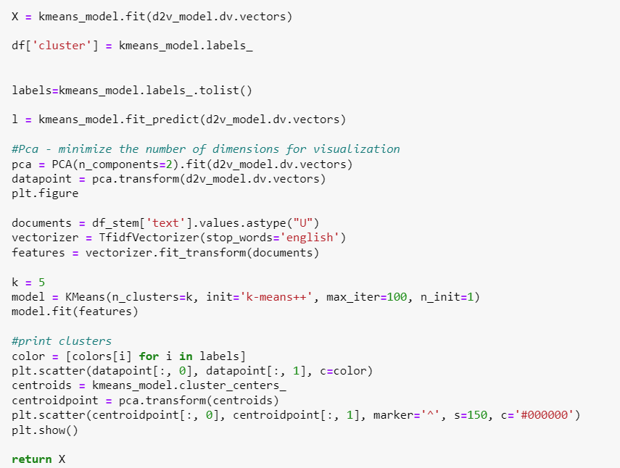
Analyzing the data and Visualizations
Creating a vector with Doc2Vec, clustering and displaying it with k-means

Slide 23
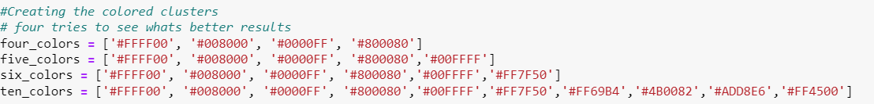
Analyzing the data and Visualizations
Creating a vector with Doc2Vec, clustering and displaying it with k-means
Creating color arrays to display the clusters, we tested four, five, six and ten clusters before deciding to continue with five clusters

Slide 24
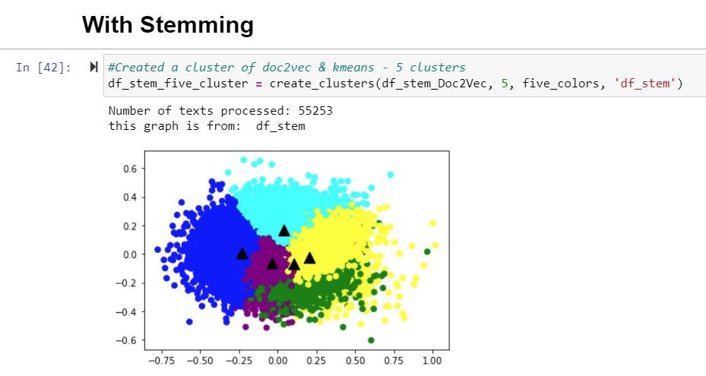
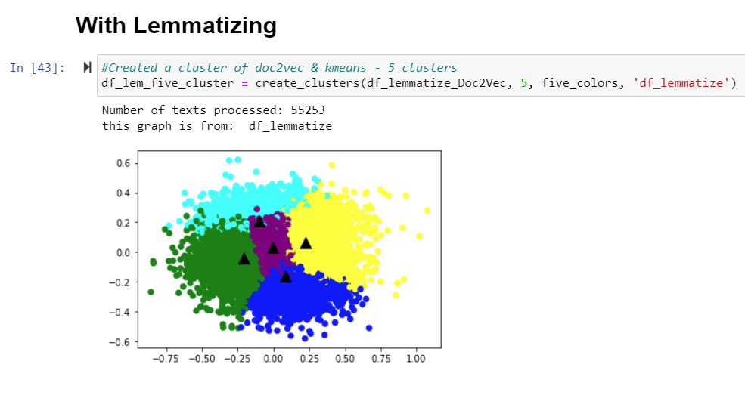
Analyzing the data and Visualizations
Creating a vector with Doc2Vec, clustering and displaying it with k-means
We could see the different spreads created by using each method

Slide 25
Analyzing the data and Visualizations
Creating a vector with Doc2Vec, clustering and displaying it with k-means
We couldn’t extract the words from each cluster with the Doc2Vec method, so we researched other ways to extract the clustered data and continued

Slide 26
Analyzing the data and Visualizations
Creating a vector with TFIDF, clustering and displaying it with k-means
TFIDF - stands for term frequency-inverse document frequency and it is a measure, used in the fields of information retrieval (IR) and machine learning, that can quantify the importance or relevance of string representations (words, phrases, lemmas, etc) in a document amongst a collection of documents

Slide 27
Analyzing the data and Visualizations
Creating a vector with TFIDF, clustering and displaying it with k-means
The stages of using the TFIDF model:
Creating vectorized data with TFIDF
Creating clusters with K-Means (clusters of 5)
Printing the dominating words in each cluster
Summing up & printing the ‘Likes’ and ‘Retweets’ each cluster received
Displaying s scatter plot of the results
We went through all the stages 2 times, once with stemmed data frame and once with lemmatized data frame

Slide 28
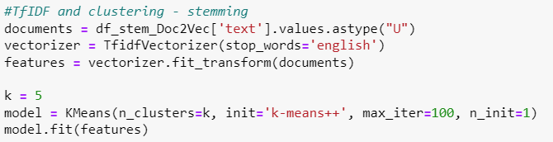
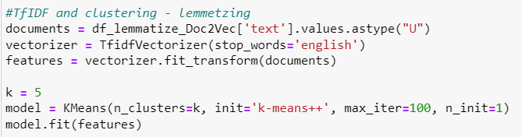
Analyzing the data and Visualizations
Creating a vector with TFIDF, clustering and displaying it with k-means
1. Creating vectorized data with TFIDF
2. Creating clusters with K-Means (clusters of 5)

Slide 29
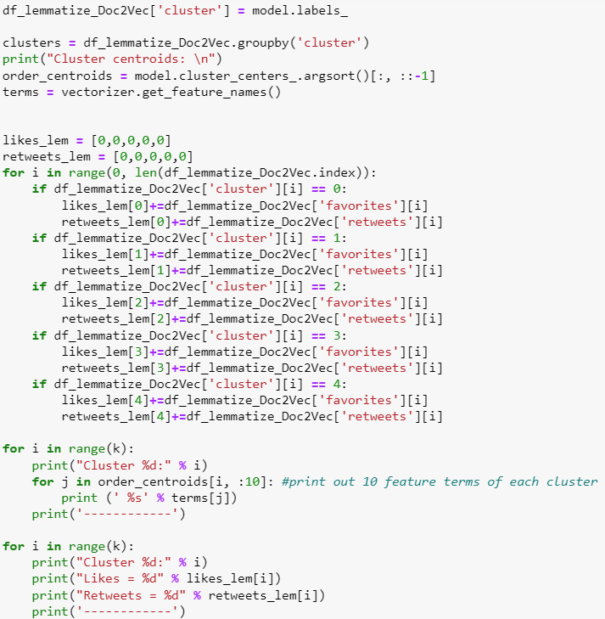
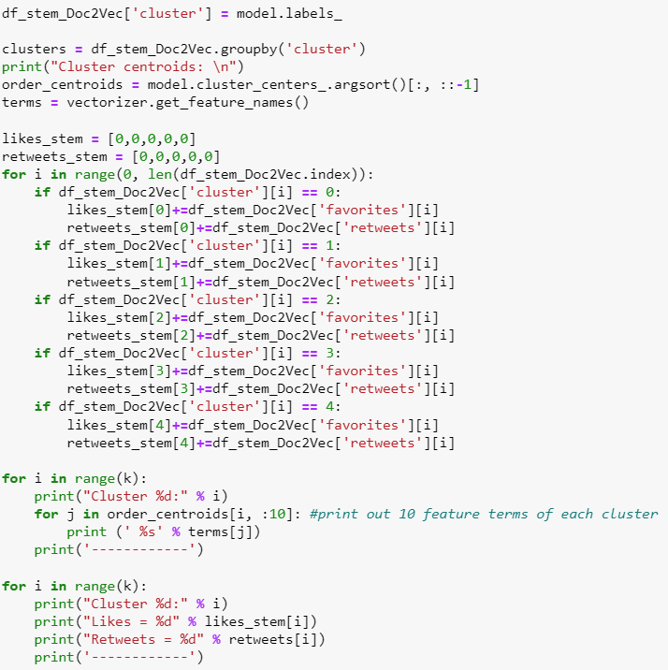
Analyzing the data and Visualizations
Creating a vector with TFIDF, clustering and displaying it with k-means
3. Printing the dominating words in each cluster
4. Summing up & printing the ‘Likes’ and ‘Retweets’ each cluster received

Slide 30
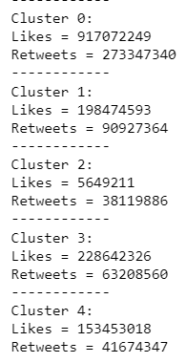
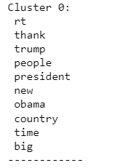
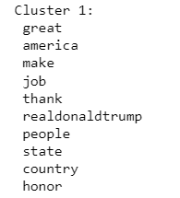
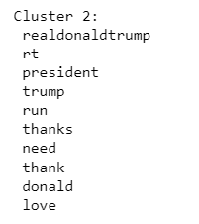
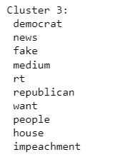
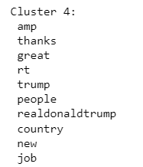
Analyzing the data and Visualizations
Creating a vector with TFIDF, clustering and displaying it with k-means
3. Printing the dominating words in each cluster
4. Summing up & printing the ‘Likes’ and ‘Retweets’ each cluster received
Stemming:

Slide 31
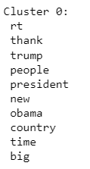
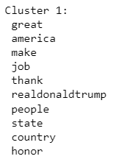
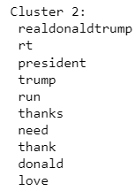
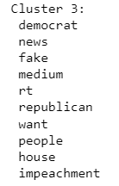
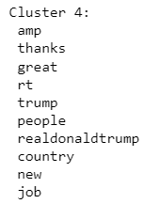
Analyzing the data and Visualizations
Creating a vector with TFIDF, clustering and displaying it with k-means
3. Printing the dominating words in each cluster
4. Summing up & printing the ‘Likes’ and ‘Retweets’ each cluster received
Lemmatizing:

Slide 32
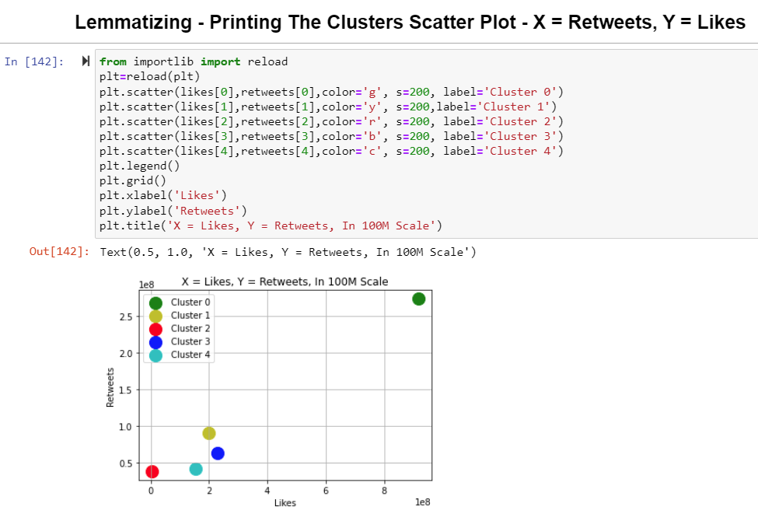
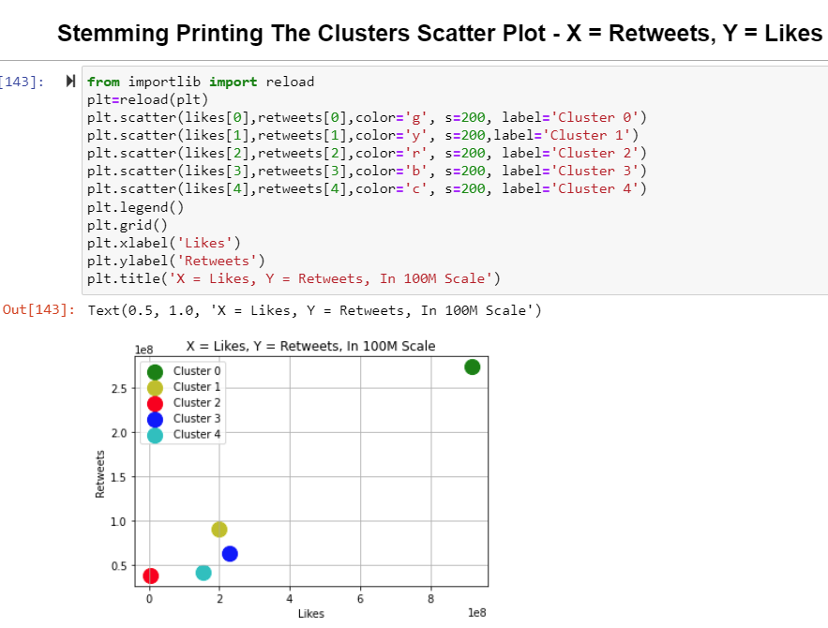
Analyzing the data and Visualizations
Creating a vector with TFIDF, clustering and displaying it with k-means
5. Displaying s scatter plot of the results

Slide 33
Analyzing the data and Visualizations
Creating a vector with TFIDF, clustering and displaying it with k-means
To our surprise both the lemmatized data frame and the stemmed data framed gave the exact same dominating word clusters and amount of likes and retweets.
It is very interesting to observe – We estimate that the to tokenized data frames gave the same root words and when using the TFIDF and K-means, the clusters were created the exact same for both of them

Slide 34
Analyzing the data and Visualizations
Naming the clusters created by the unsupervised learning TFIDF algorithem:
Trump's campaign in 2016 and the confrontation with Barak Obama
Donald Trump's election promises
Demonstration of love towards the electorate
The media and “Fake News”
Promises regarding economic development, job creation and more

Slide 35
Analyzing the data and Visualizations
According to the data analysis, after summing the ‘Likes’ and ‘Retweets’ that each cluster received with the TFIDF model, the topic that Donald J. Trump had the most impact on with the public is: Cluster 0
Trump's campaign in 2016 and the confrontation with Barak Obama for the presidency
Trump's campaign in 2016 and the confrontation with Barak Obama

Slide 36
Analyzing the data and Visualizations
After completing our research question, we wanted to investigate another unsupervised learning algorithm and see if the word clusters it provides, come in fit with the TFIDF model we made – again with both the stemmed & lemmatized data frames, and as before, we created clusters of 5
We chose LDA - a form of unsupervised learning that views documents as bags of words (ie order does not matter). LDA works by first making a key assumption: the way a document was generated was by picking a set of topics and then for each topic picking a set of words.
This time, each data frame provided a slightly different set of clusters
We didn’t sum up the ‘Likes’ and ‘Retweets’, only created the clusters and concluded the different titles of them

Slide 37
Analyzing the data and Visualizations
Lemmatizing:
Creating the LDA corpus and training the model:
Using lda_vis to display the word clusters:

Slide 38
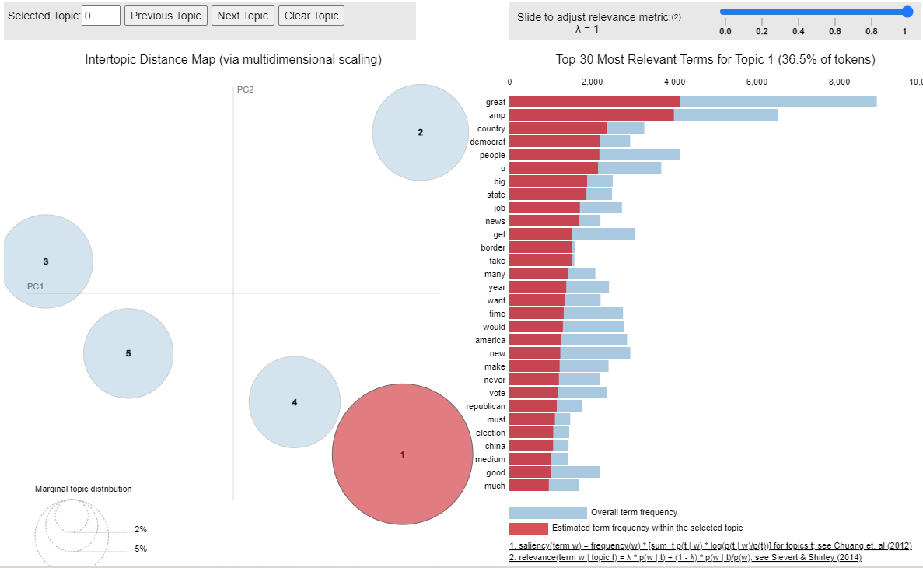
Analyzing the data and Visualizations
Trump's second campaign
Lemmatizing:
Cluster 1:
Trump's second election campaign – focus on foreign policy –
words like: border, fake news, vote, china, election, state

Slide 39
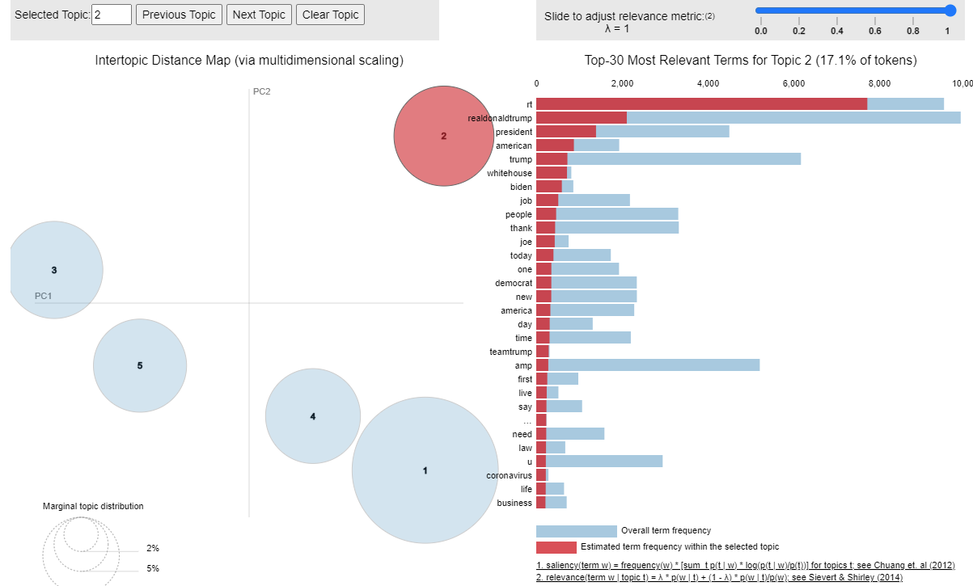
Analyzing the data and Visualizations
Trump's second campaign
Lemmatizing:
Cluster 2:
Trump's election campaign against Joe Biden and around the Corona virus –
words like biden, joe, democrat, live, coronavirus, life, law

Slide 40
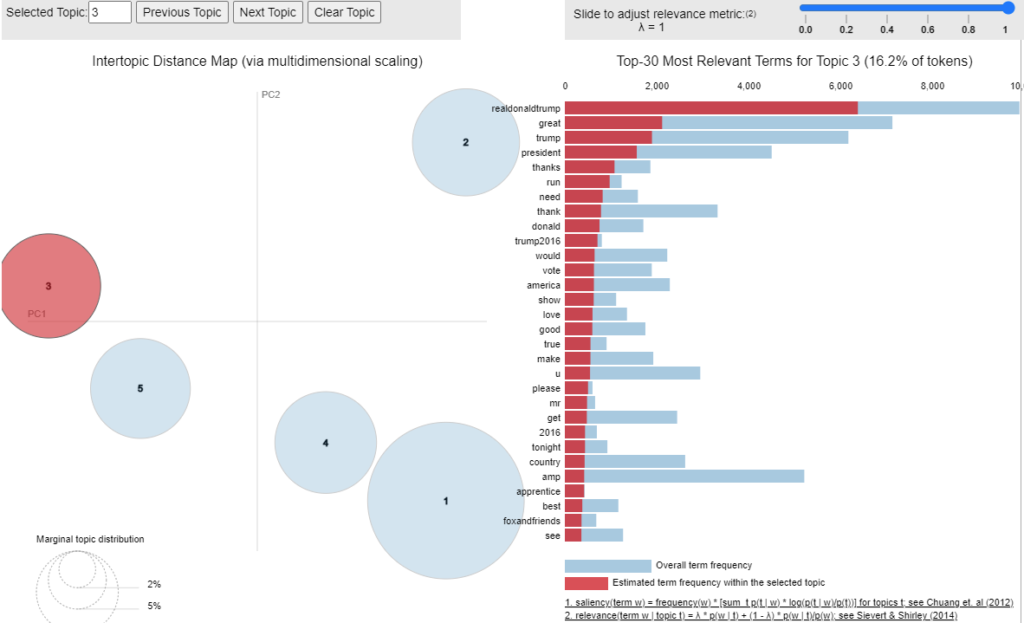
Analyzing the data and Visualizations
Trump's second campaign
Lemmatizing:
Cluster 3:
Trump’s first election campaign in 2016 –
words like : 2016, trump2016, vote, president, trump, make, great, run, show

Slide 41
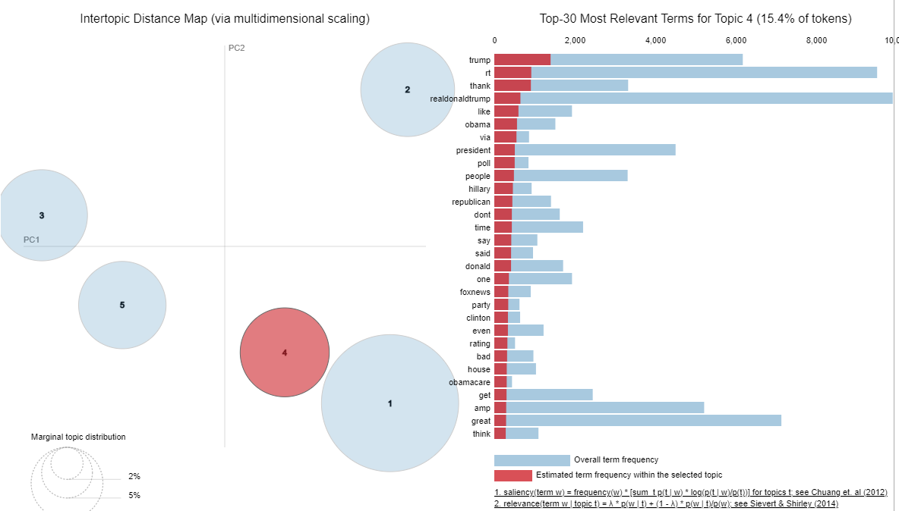
Analyzing the data and Visualizations
Trump's second campaign
Lemmatizing:
Cluster 4:
Trump’s first election campaign focused on Barak Obama and Hilary Clinton –
words like : Obama, Hilary, Clinton, Obamacare, poll, president, bad, republican

Slide 42
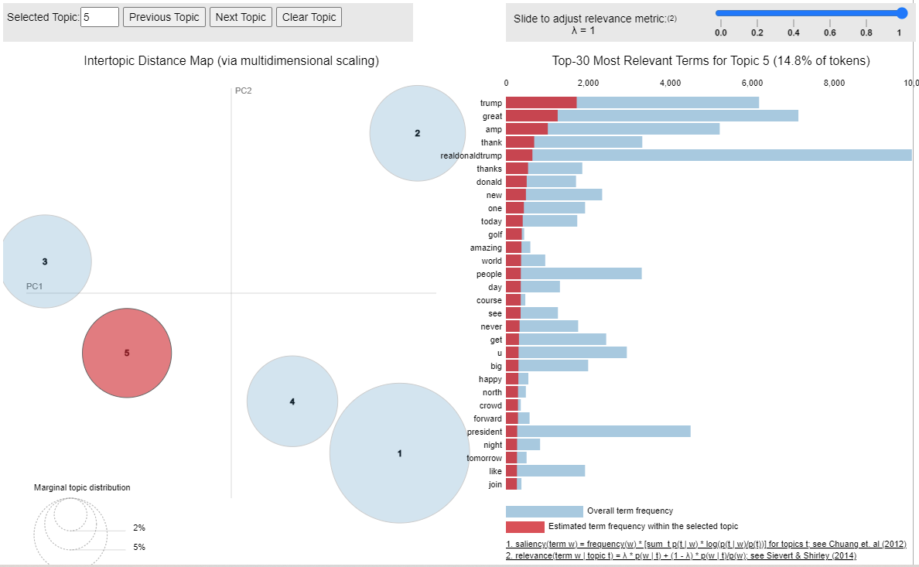
Analyzing the data and Visualizations
Trump's second campaign
Lemmatizing:
Cluster 5:
Demonstration of love towards the electorate –
words like : amazing, people, happy, forward, join, great

Slide 43
Analyzing the data and Visualizations
Stemming:
Creating the LDA corpus and training the model:
Using lda_vis to display the word clusters:

Slide 44
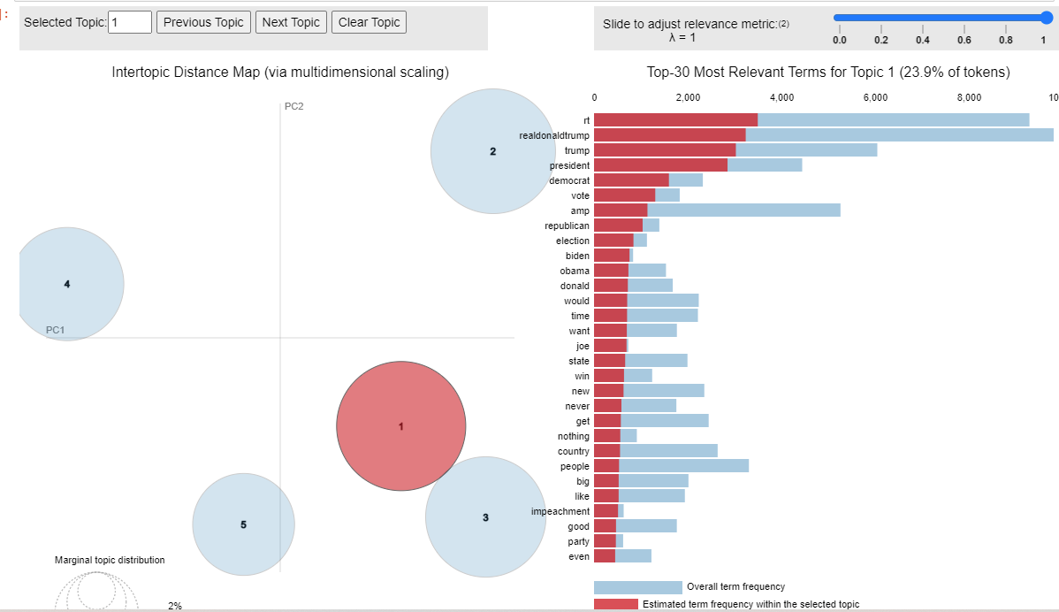
Analyzing the data and Visualizations
Trump's second campaign
Stemming:
Cluster 1:
Trump's election campaign against Joe Biden and around the Corona virus –
words like biden, joe, democrat, republican, election, state, win, impeachment

Slide 45
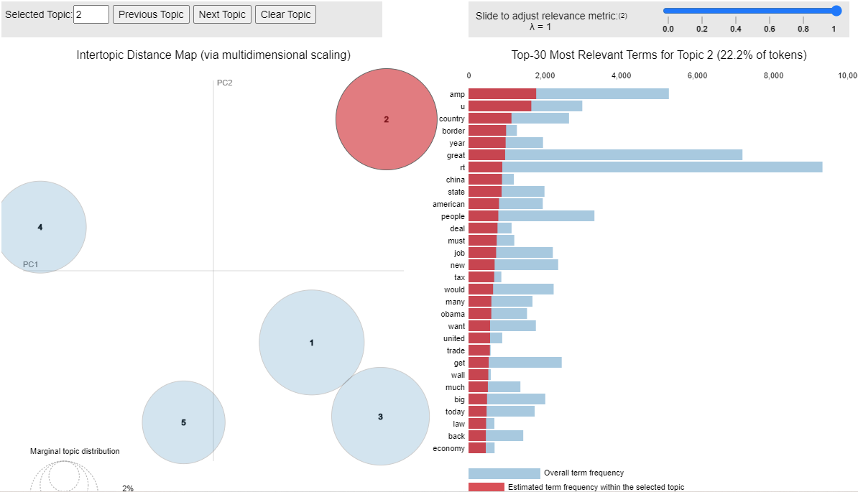
Analyzing the data and Visualizations
Trump's second campaign
Stemming:
Cluster 2:
Foreign policy, domestic policy and economy - words like: border, china, state, job, tax, trade, wall, law, economy

Slide 46
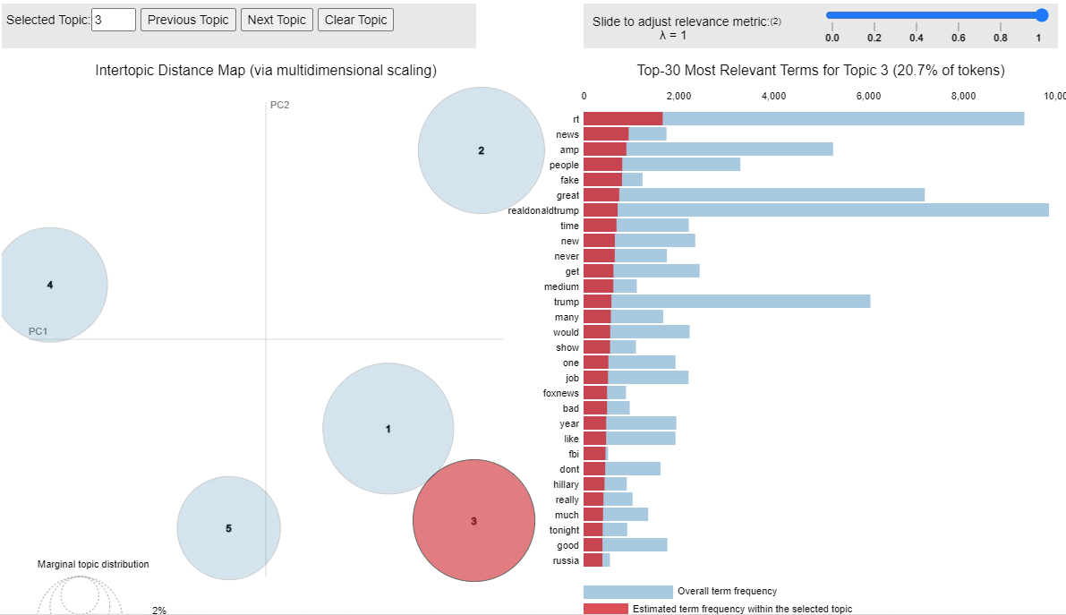
Analyzing the data and Visualizations
Trump's second campaign
Stemming:
Cluster 3:
The media
- words like: fake, news, medium, show, foxnews, bad

Slide 47
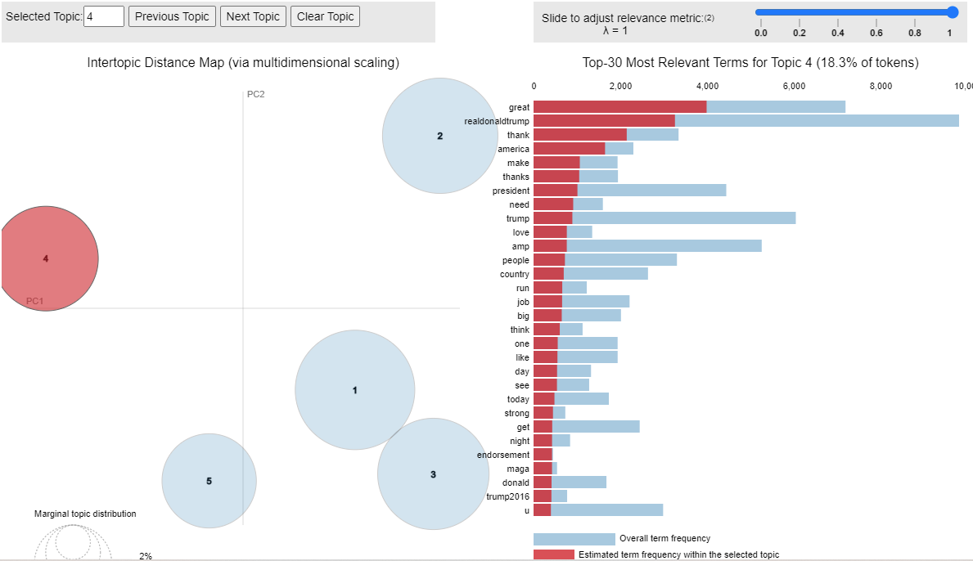
Analyzing the data and Visualizations
Trump's second campaign
Stemming:
Cluster 4:
Demonstration of love towards the electorate
- words like: thank (twice), love, people, like, strong, endorsement

Slide 48
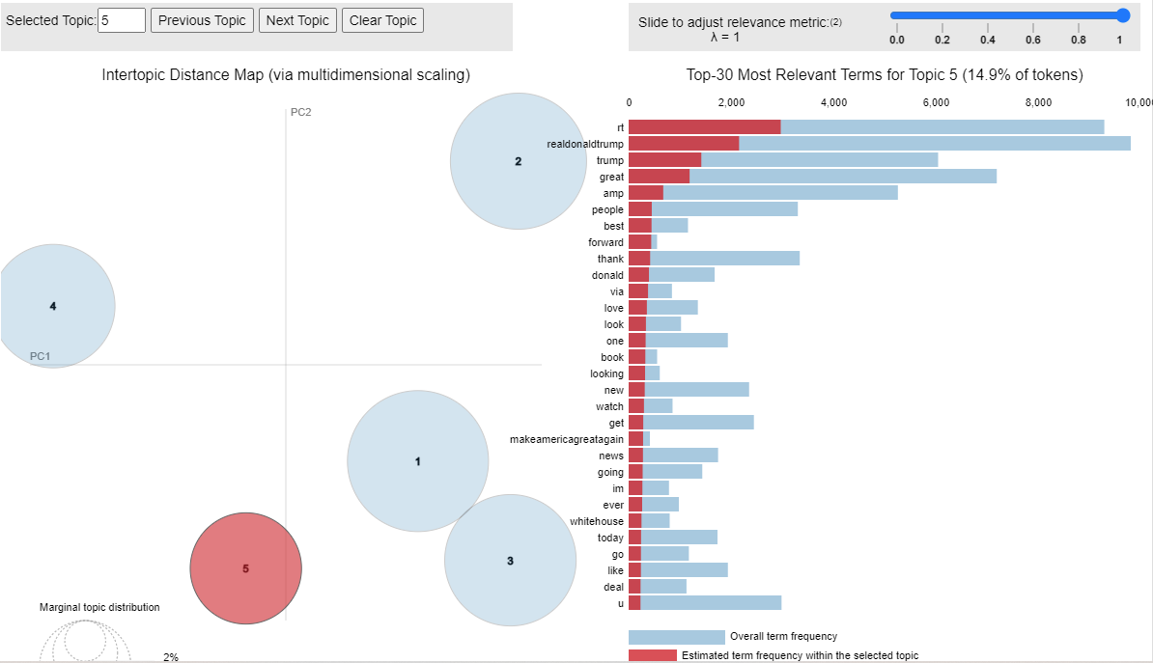
Analyzing the data and Visualizations
Trump's second campaign
Stemming:
Cluster 5:
Trump's election campaign
- words like: makeamericagreatagain, great, forward, im, going, whitehouse, deal, new

Slide 49
Analyzing the data and Visualizations
Trump's second campaign
Cluster 1:
Trump's second election campaign – focus on foreign policy –
words like: border, fake news, vote, china, election, state
Cluster 2:
Trump's election campaign against Joe Biden and around the Corona virus –
words like biden, joe, democrat, live, coronavirus, life, law
Cluster 3:
Trump’s first election campaign in 2016 –
words like : 2016, trump2016, vote, president, trump, make, great, run, show
Cluster 4:
Trump’s first election campaign focused on Barak Obama and Hilary Clinton –
words like : Obama, Hilary, Clinton, Obamacare, poll, president, bad, republican
Cluster 5:
Demonstration of love towards the electorate –
words like : amazing, people, happy, forward, join, great
Lemmatizing
Cluster 1:
Trump's election campaign against Joe Biden and around the Corona virus –
words like biden, joe, democrat, republican, election, state, win, impeachment
Cluster 4:
Demonstration of love towards the electorate
- words like: thank (twice), love, people, like, strong, endorsement
Cluster 5:
Trump's election campaign
- words like: makeamericagreatagain, great, forward, im, going, whitehouse, deal, new
Cluster 2:
Foreign policy, domestic policy and economy - words like: border, china, state, job, tax, trade, wall, law, economy
Cluster 3:
The media
- words like: fake, news, medium, show, foxnews, bad
Stemming

Slide 50
Analyzing the data and Visualizations
Trump's second campaign
Although there is a difference between LDA in the STEMMING method compared to the LEMMATIZING method, a clear correlation pattern can be seen between the two regarding the subject of clusters
Between the LDA and TFIDF methods one can also see a clear recurrence of the issues in the different clusters - i.e. the models work differently, but in the end lead to similar results

Slide 51
Trump's second campaign
Machine Learning
We used 3 different machine learning algorithms and experimented with each of them, tested the differences between them and understand each of their work mechanisms
For each model we created the appropriate function which were introduced during phase 4
TFIDF
Doc2Vec
LDA

Slide 52
Conclusion
After analyzing all of Donald Trump's tweets in more than a decade of activity on Twitter, one can clearly see the topics that most influenced public opinion, what his followers liked, and what they posted themselves. Trump's first run in the US presidential election was the most influential issue, followed by his second run, as well as issues such as foreign policy, the economy, and the sympathy of his followers.
After we finished the project we think that the LDA is the best unsupervised machine learning algorithm – it has the easiest initializing as well as clear and comfortable UI

